Slide 1

Practical lesson in English

Slide 2
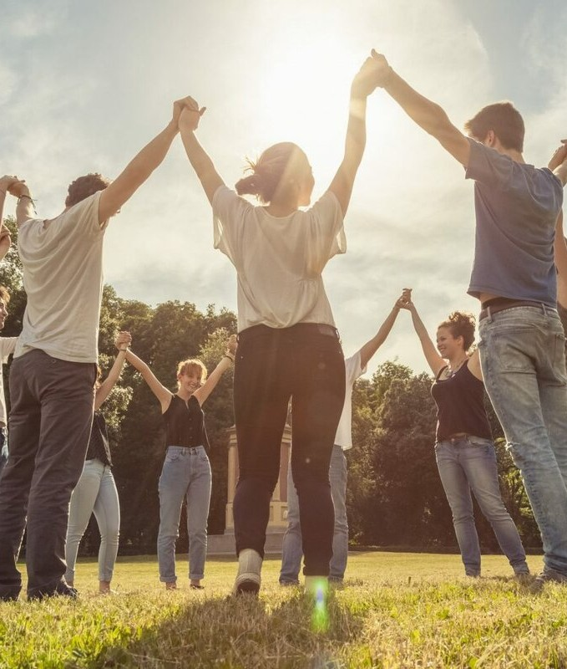
Игpa (инgтpyкция)
Let's us make a circle. The first person calls his name and asks his neighbor's name and so on. Let me get started.
And now, let's move on to the topic of the lesson. Today we will take about the people around you.

Slide 3
Card Assignment (Зaдaниe кapтouки)
You are a big family. Now we’ll give you cards with pictures of family members and their characteristics. You have 3-4 minutes to look at the pictures together and try to remember who is who.
Now we’ll distribute these pictures separately and each of you will go out and tell information about yourself from the card. The other students have to guess which family member they are talking about.

Slide 4
Video about family members
And now, our dear students, I will show you a video. It will make it easier for you to remember family members. I will show the video twice. The first time you have to watch it carefully, and the second time you will repeat the movements as in the video. You have to remember 5 family members, be attentive! Enjoy the video!

Slide 5
M Y M O T H E R ' S F A T H E R I S M Y . . . .
M Y G R A N D F A T H E R ' S W I F E I S M Y . . . .
RIDDLES
And now we will test your ability to memorize new words in a short period of time. We will read riddles, and you try to guess them.
M Y A U N T ' S D A U G H T E R I S M Y . . . .
M Y S O N ' S S I S T E R I S M Y . . . .

Slide 6
M Y D A U G H T E R ' S S O N I S M Y . . . .
M Y D A U G H T E R ' S B R O T H E R I S M Y . . . .
M Y M O T H E R I S M Y F A T H E R ' S . . . .
M Y M O T H E R A N D M Y F A T H E R A R E M Y . . . .

Slide 7

Associative bush (Аggoциaтивный кygт)
Guys, I suggest working with the association method. You need to split into 2 teams, for this. I explain the rules of this method:
you write any word that you associate with the word "family" (or another word). For example: Family→ father→ love→ care.
Words should not be repeated.
All team members must be cooperative.
1 word - 1 point.

Slide 8
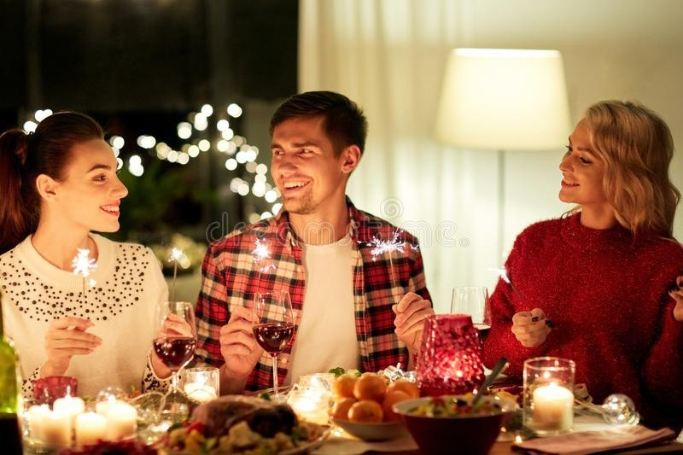
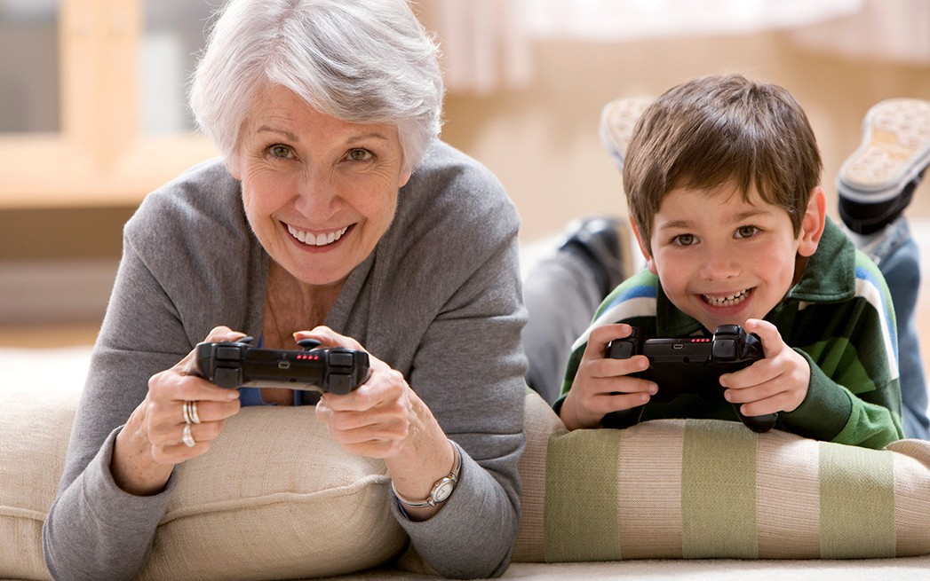
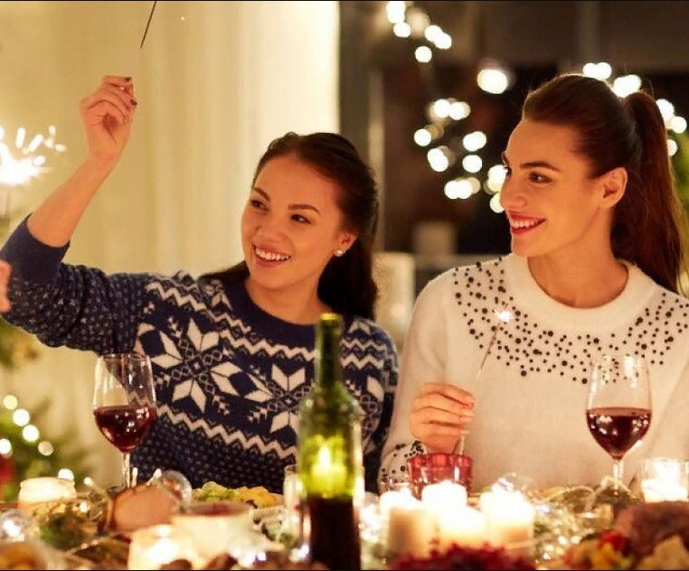
IN THE PICTURE YOU CAN SEE KARINA ON HER 21ST BIRTHDAY. YOU WILL NEED TO LISTEN THE AUDIO AND WRITE THE GIRL'S RELATIONSHIP WITH EACH PERSON.
Karina a Dannyy
b Nikita
d Jean
e Richard
c Holly

Slide 9
You will need to listen to the audio again and put the missing words in the sentences. But before you start the task, look through the text fullу and pay attention to the words next to the gaps. Think about which part of speech the missing word belongs to.
Karina is showing her colleague some photos of her birthday party.
Nikita lives __________ from Karina. She is also Karina's brother's __________.
Danny usually lives __________ , but at the moment he's staying with his aunt and uncle in Edinburgh. He __________ a design course at Edinburgh College of Art.
Danny __________ the course, but he doesn’t really know what he wants to do.
Holly looks __________ Karina, but she's actually her __________ .
Karina's grandmother is getting __________ so she needs more help these days. She stays with Karina's family at the __________ .
Richard looks so grown up. He's getting really __________ .

Slide 10
Writing a letter
High school students are usually given an excerpt from a letter from a potential pen friend during an exam. The letter contains some news and several questions where you are asked for opinions, advice, etc.
It is required to write a response letter, starting with your short return address in the upper right corner, the date under the address, greetings and ending with a farewell phrase and name. The requirements for the letter are 100-140 words. Volume requirements must be met. Remember that the necessary repeatable elements of the letter are:
the address, the addressing form (Dear Alice);
thanks for the received letter (Thanks for your letter/ It was great to hear from you); final phrases (like Write soon. Best wishes);
your name at the end letters;
Bear in mind these phrases and visually remember the scheme of the parts of the letter.

Slide 11
Example of a letter
Dear Adam,
Thanks a lot for your letter. It was nice to hear from you.
In your letter you told me that your parents disapprove of your girlfriend. Well, it happens very often. Fortunately, I don’t have any conflicts with my parents. They get on well with my girlfriend. I always follow their advice because they have more life experience than I do. But if misunderstandings occur, we openly discuss any problems and try to come to a joint decision. My relations with parents are based on trust and mutual understanding rather than on domination or prohibition.
My congratulations! Have you ever attended any concerts? What is your favorite singer? Are you going there alone or with your friends?
I’d better go now. My friend is calling. Keep in touch. Best regards,
Michael (133 words)

Slide 12
Homework
Our fascinating lesson has come to the end. I hope you enjoyed the lesson. The homework will be writing a response letter. Do you have any more questions?

